Slide 1
CONSUMER BEHAVIORAL SYSTEM
- DONE BY ,
AMIT KUMAR YADAV
PULIYANDA LAVA NANCY
SHETTI ASHOK KUMAR
HARI VAMSI CHITTURI

Slide 2
SCOPE OF THE CUSTOMER INFORMATION SYSTEM
The purpose of the software requirements document is to systematically capture requirements for the project and the system “Customer Information System” to be developed. Functional requirements of this system are captured in this document. It also serves as the input for the project scoping.
The scope of this document is limited to addressing the requirements from a user, quality, and non-functional perspective. It is recommended that design aspects are not added in this document

Slide 3
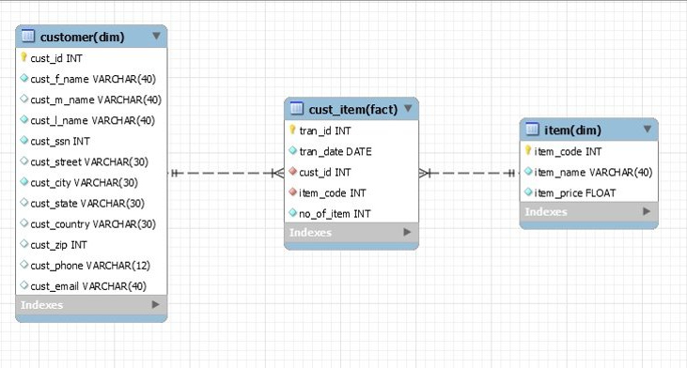
Data Warehouse

Slide 4
TECHNOLOGY USED
1 . Hadoop
  a) HDFS
  b) MapReduce
2. Hive
3. Spark

Slide 5
ADVANTAGES
HADOOP
Highly Available. ​
Open Source.
Data Locality​​
Low Network Traffic.​​
High Throughput.​​
Multiple Language Support
Compatibility & Scalable.​

Slide 6
HIVE
Hive Operates On Top Of Hadoop.
Keeps Queries Running Fast.
Multiple User Can Query The Data.
Hive Supports All Extensions.
Large Dateset Support & Multi-user
SPARK
Dynamic In Nature.
Powerful.
Advanced Analytic​
Re-usability​
Real Time Stream-Processing.

Slide 7


WORK-FLOW DIAGRAM
Local Raw Data(CSV)

Slide 8
OUTPUTS

Slide 9


Screen Shots
Q2)
Q3)

Slide 10
Q4)

Slide 11
Q5)

Slide 12


Q6)

Slide 13
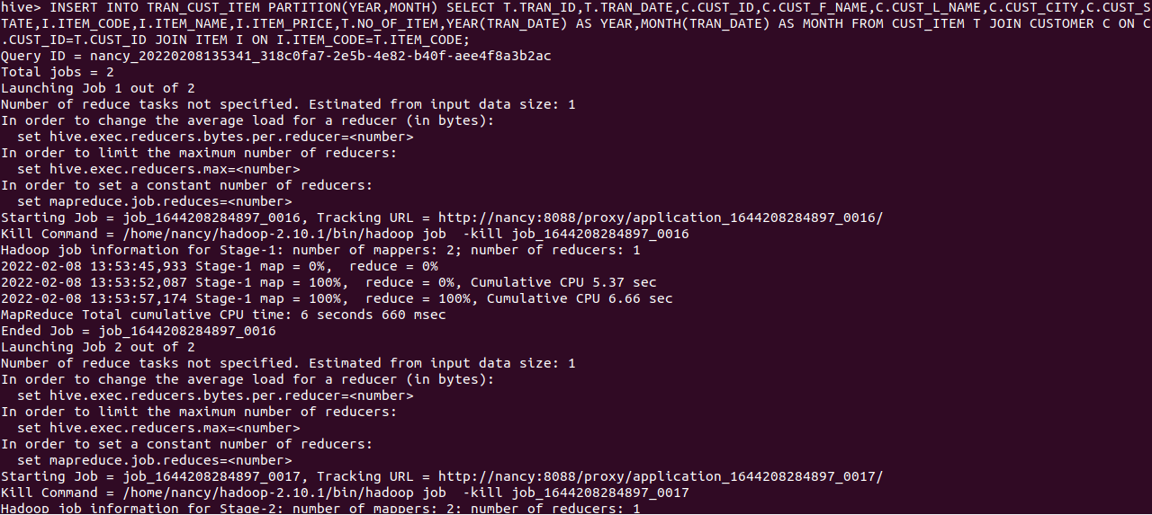
Q7)

Slide 14
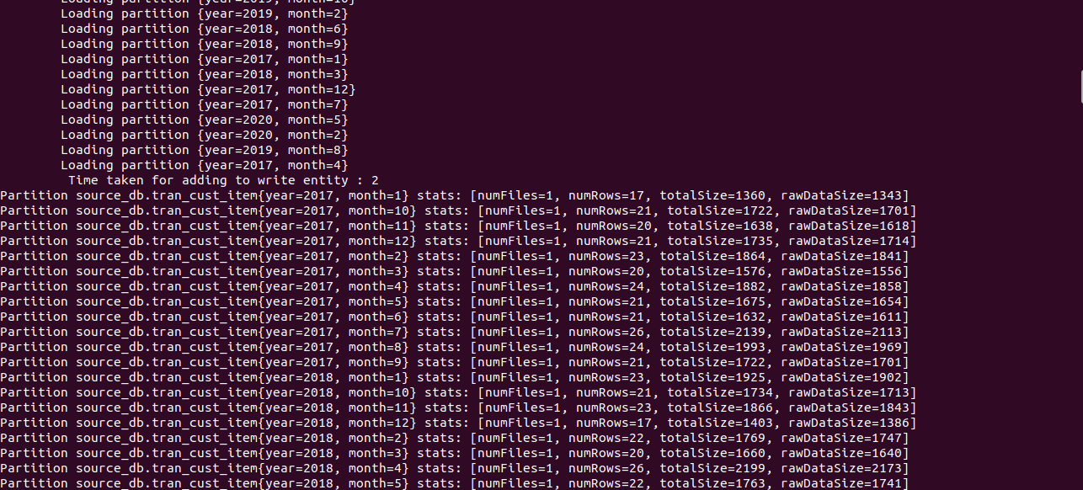

Slide 15

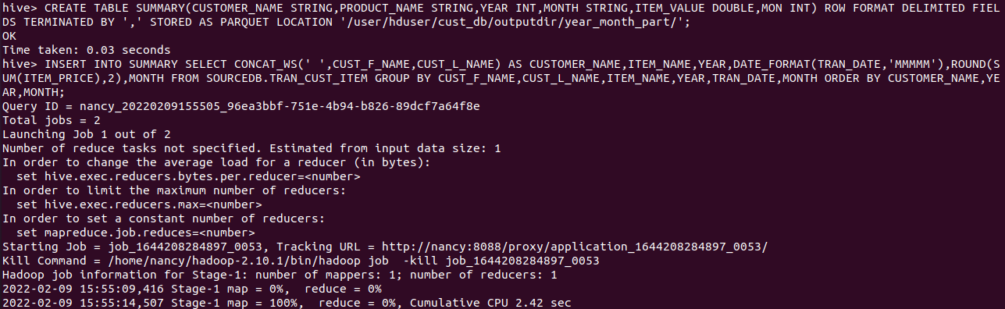
Q8)
Q9) 1)

Slide 16
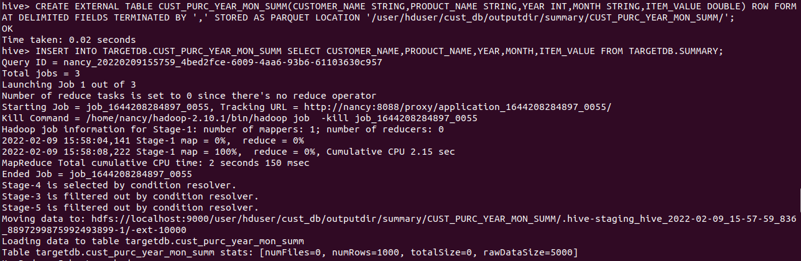

Slide 17
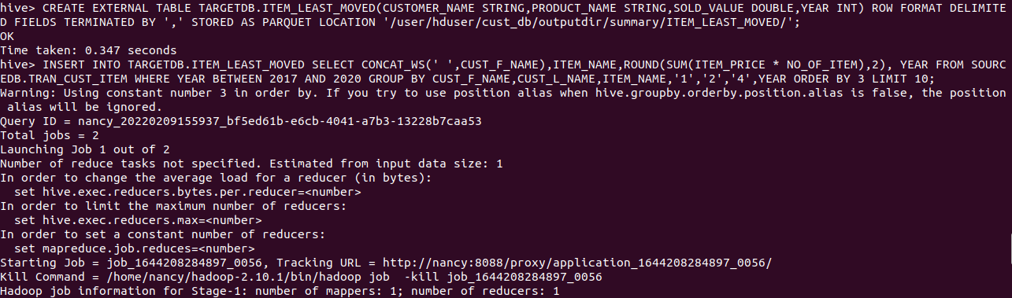
Q9)
2)

Slide 18
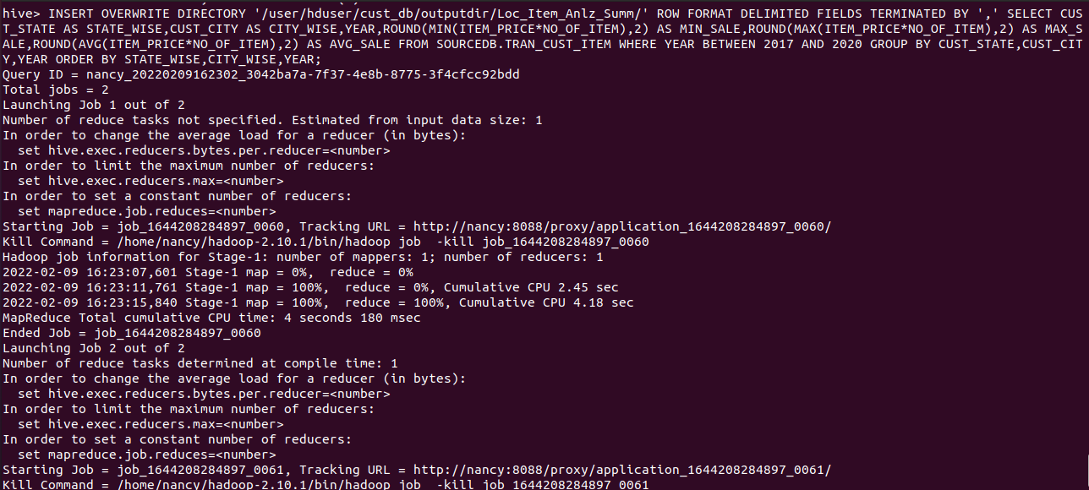
Q9)
3)

Slide 19
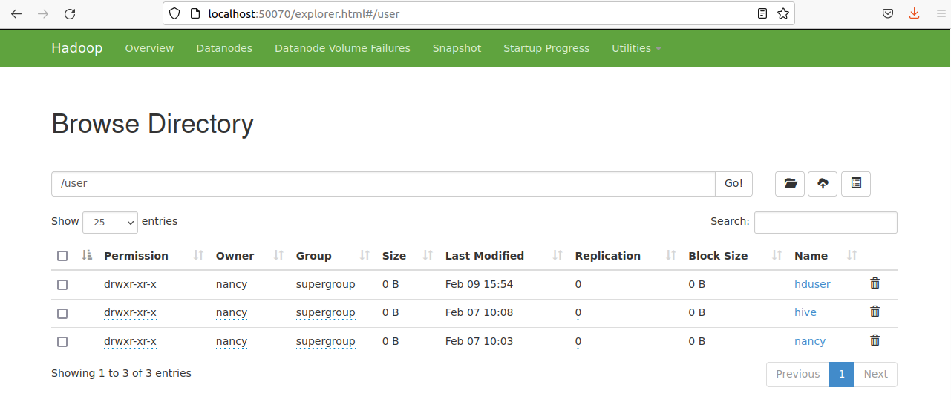
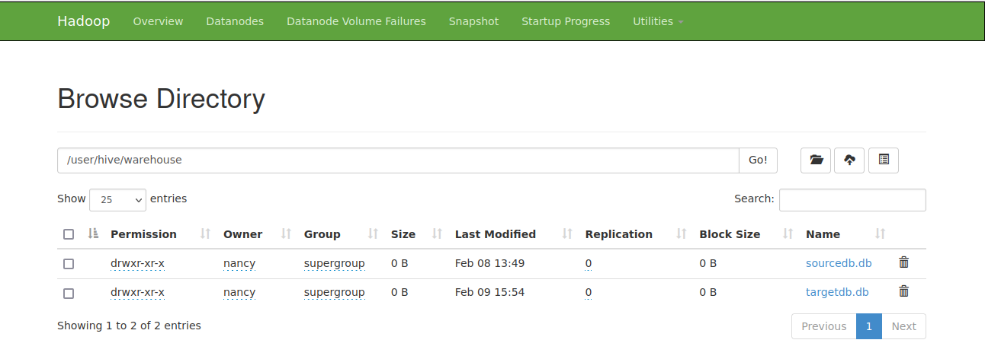
Q10)

Slide 20
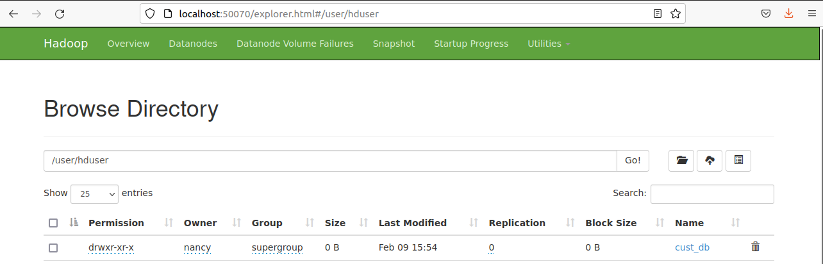

Slide 21
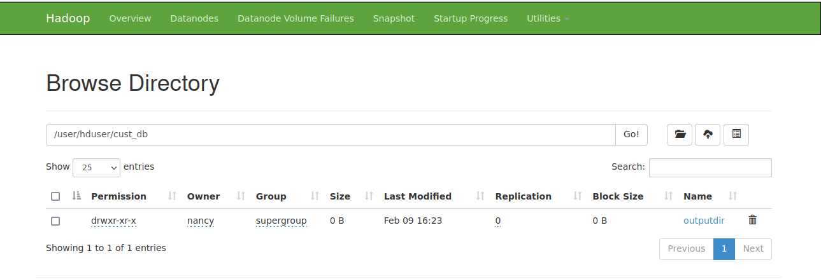
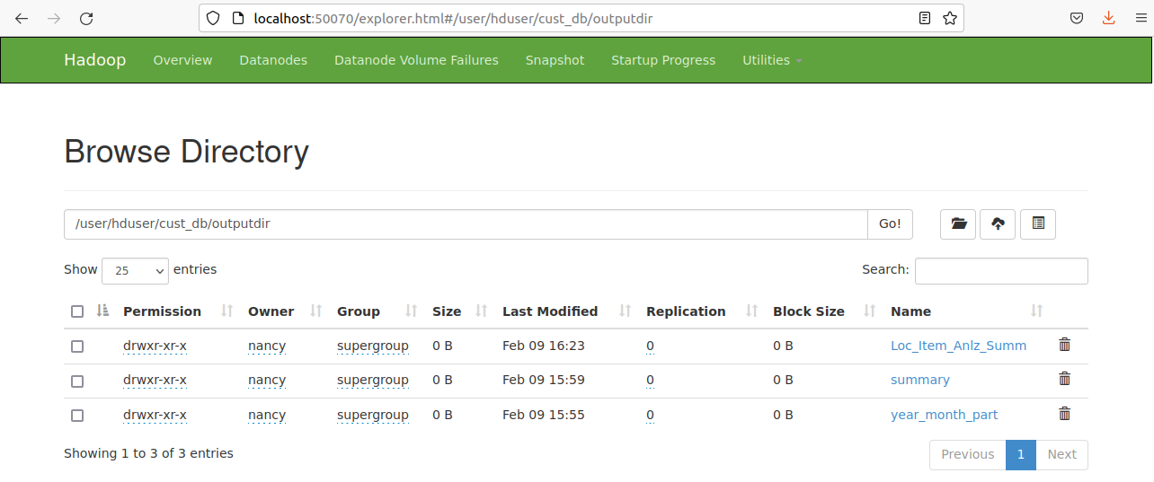
Q11)

Slide 22
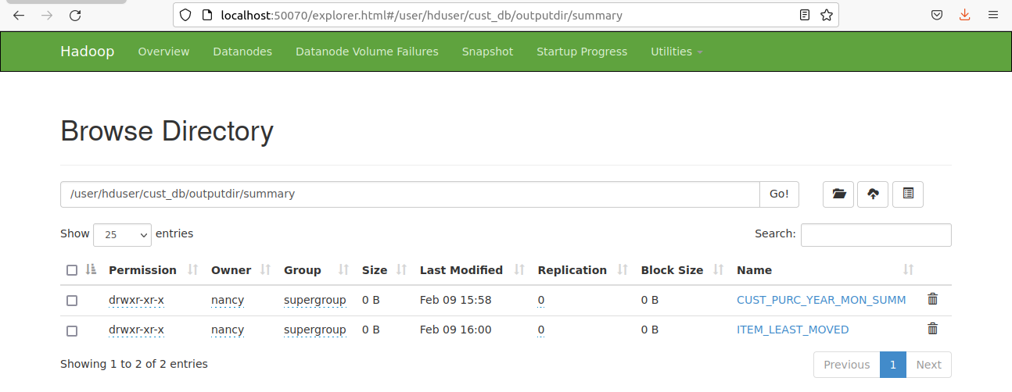

Slide 23
Outcome
Provided data for the regulation of the demand and supply for the customers and the suppliers.
Provided data to improve the sales, specific to location for a given timeline (Daily, Weekly, Quarterly, Monthly, Annually)
Analysed the customer purchase behaviour based on different range of time.
Extracted information of high value customers and high demand products, that can be used by supply chain department.
Ranked items and value customers for sale and offer application.

Slide 24
THANK YOU

